Slide 1

Netflix Analysis using Tableau and SQL
Visualizing Key Metrics for Decision Making
by Anamika singh
as

Slide 2
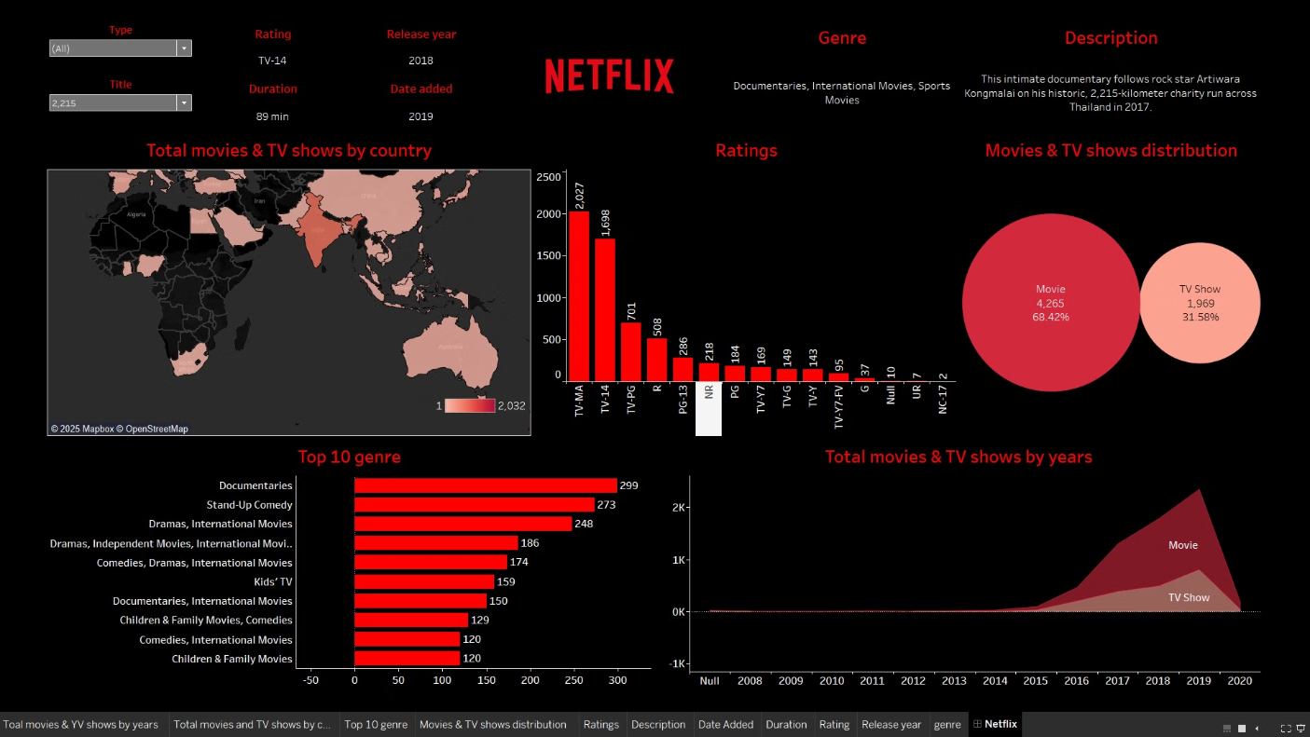
Tableau Analysis

Slide 3

Understanding the Business Need
Sales, Discounts, Profit
Across countries and products
Data-Driven Insights
Improve performance and decision-making
Key Trends
Spot opportunities and challenges

Slide 4
How the Data Was Prepared
Data Import
Data Cleaning
Column Additions
From CSV or database
Fix missing values, errors
Profit margins, etc.

Slide 5

What the Data Shows
1
Total Sales by Product
2
Total Discounts
3
Total Profit
Overall discounts applied
Profitability across products
Paseo, Amarilla, etc.

Slide 6
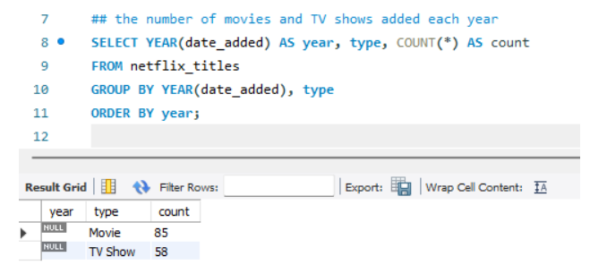
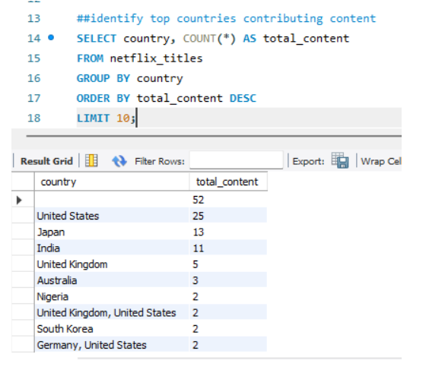
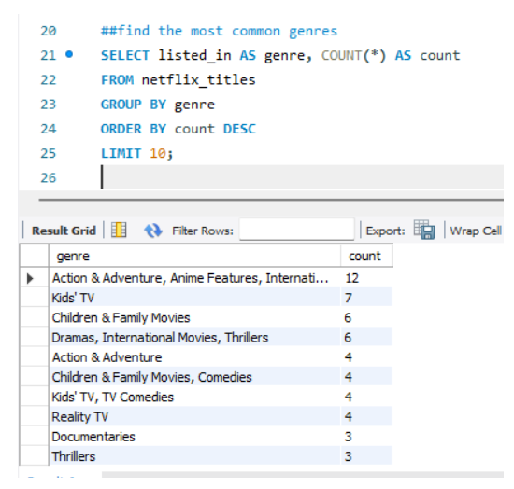
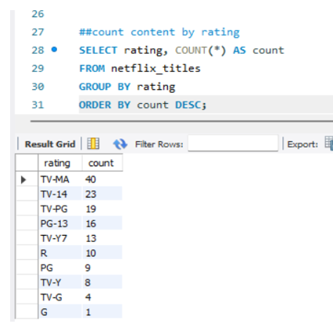
Sales by Product
Sales Performance
Descriptive Analysis
Targeted Efforts
The products are leading are movie
Marketing and sales focus

Slide 7
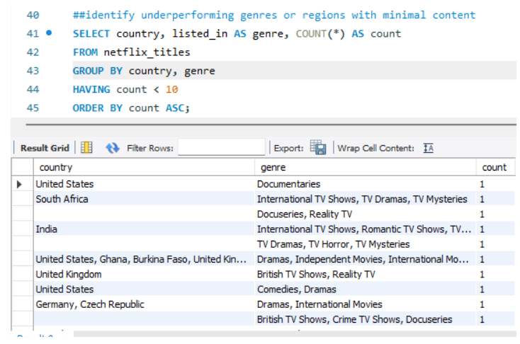
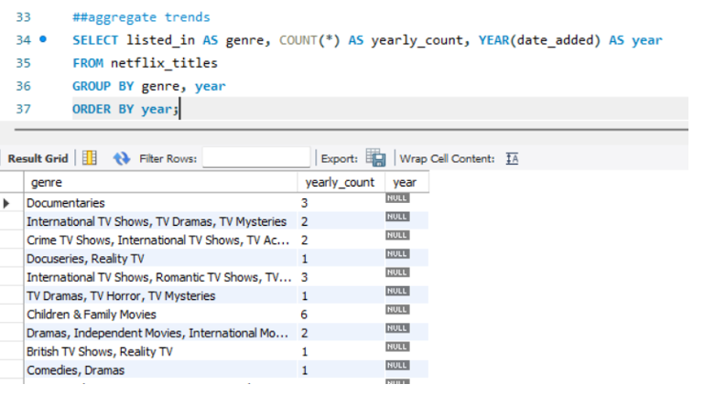
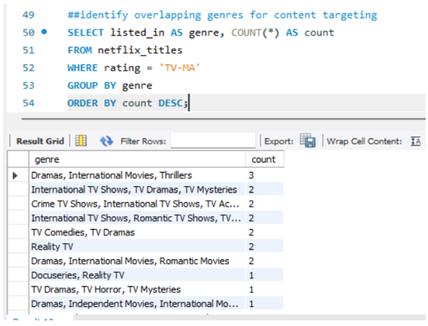
Discounts and Profit Analysis
Discount Impact
Predictive Analytics and Prescriptive Analytics
Profit Contribution
How discounts affect profits
The products drive profits are movie

Slide 8


Sales Trends by Year and Month
Sales trends over the years
Seasonal sales patterns
1
2
3
High and low sales months

Slide 9




Key Insights
Top Performers
Paseo, Amarilla
High Sales
France, others to target
Discount Management
Balance discounts with profits

Slide 10




Actions Based on Insights
Promote Best-Sellers
Maximize product sales
Adjust Discount Strategy
Maintain profitability
Increase Marketing
Canada, Mexico, etc.

Slide 11



Final Thoughts
1
Smarter Decisions
Data-Driven Insights
2
Sales, profits, discounts
3
Effective Business Strategies

Slide 12
THANK YOU
by Anamika singh
anamika.s1026@gmail.com

